Slide 1
LocalPass
A Centralized Hub for Discovering Local Community Events
Presenter: Gaurav Patil

Slide 2
Project Overview: LocalPass
The Solution
A native Android app to find local events & acquire digital passes.
Key Feature: Universal Check-In
Verifies entry and participation.
Location Logic: GPS restricts check-ins to 150m radius.
Technical Implementation
Framework: Flutter (Dart)
Backend: Google Firebase (Auth & Firestore)

Slide 3
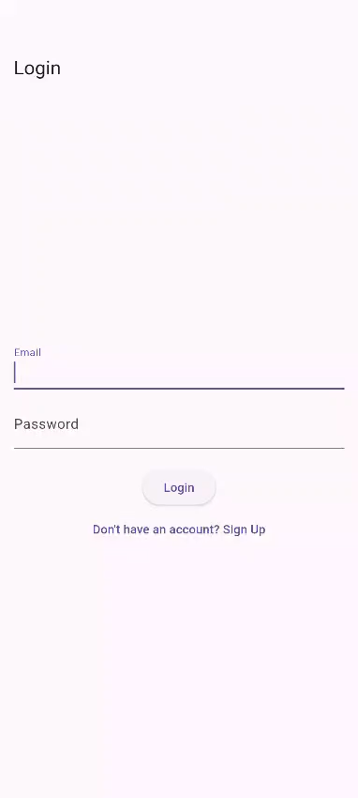
Login

Slide 4
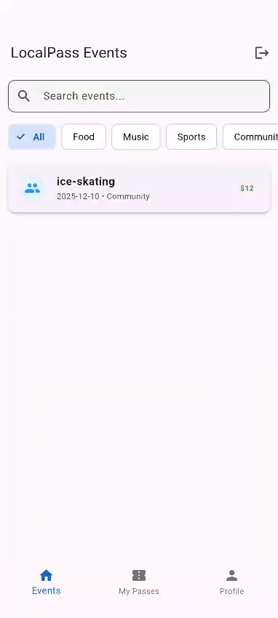
Event Addition

Slide 5
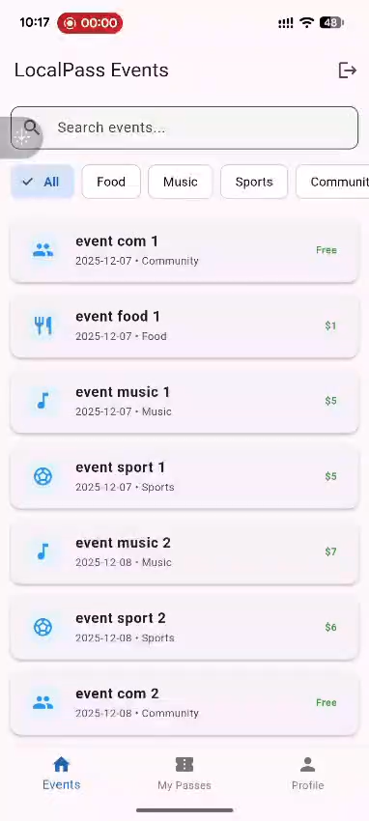
Buy new pass

Slide 6
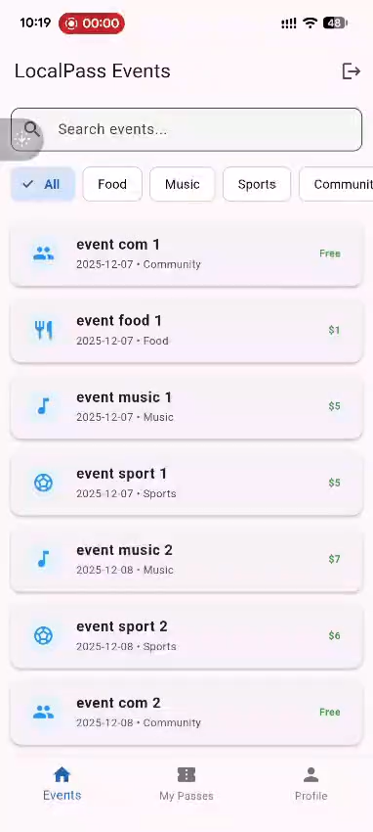
Duplicate pass validation

Slide 7
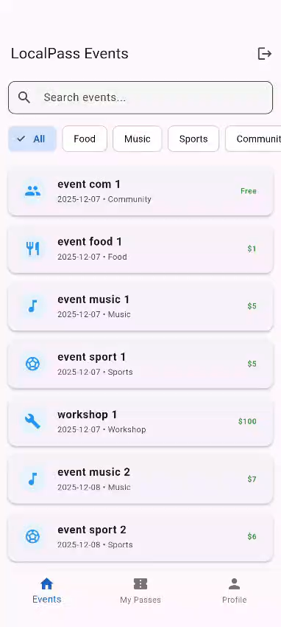
Insufficient Balance Validation

Slide 8
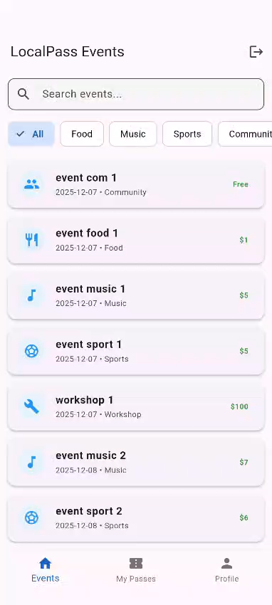
Sales Close Validation

Slide 9

Check-in out of radius

Slide 10
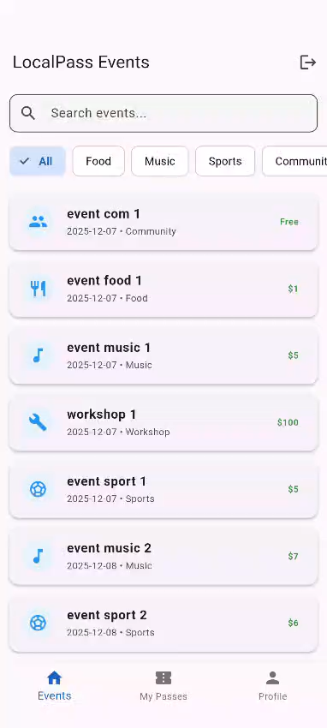
Check-in in radius

Slide 11
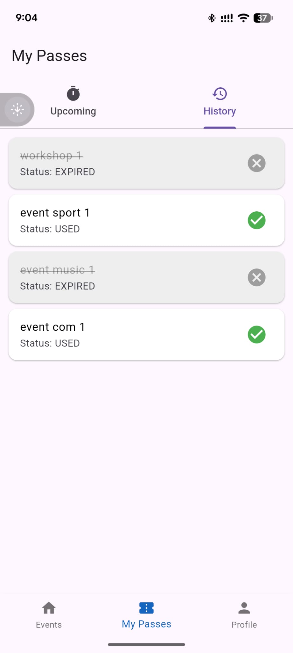
Expired Passes

Slide 12
Thankyou

